Slide 1
Missouri State University Strategic Enrollment Management (SEM) Plan for Student Success 2020-2026
Board of Governors
Dr. Rob Hornberger, Associate Vice President of Enrollment Management & Services
Dr. Tammy Jahnke, Dean of the College of Natural and Applied Sciences
December 10, 2020

Slide 2
Factors That Led to the Development of a SEM Plan
Enrollment Challenges
Fewer HS graduates and transfer students
Decreasing undergraduate degree seeking enrollment
Students graduating earlier
Declining underrepresented and international student enrollment
Economy/employment
Increased competition
Learning modalities
Value of a degree
Enrollment Opportunities
Graduate education
Dual credit programs
Certificate programs
Learning modalities

Slide 3
Summary of Key Steps
Summer/Fall 2019
Buy-in from leadership and key stakeholders
BOG August retreat
Met weekly with Administrative Council
Set Guiding Principles
Developed committee/council structure
Emphasized faculty involvement
Committee leads attended national conference on SEM
Hired consultant and plan writer
Hosted a SEM Kickoff event
Created SEM goals
Spring 2020
Campus-wide townhall meeting
Developed strategy drafts
Pandemic pause
Fall 2020
Coordinated with LRP and Vision Plan efforts
Narrowed scope and reassessed goals and strategies
Completed final plan narrative

Slide 4
Presentation Topics
Final goals and strategies
Organizational structure for oversight going forward
Assessment
Tactics (action items used to achieve goals and strategies)

Slide 5
Our 4 Strategic Enrollment Goals
1. Outreach and Recruitment
3. Successful Graduation and/or Completion
2. Retention and Student Success
4. Financial Preparedness
Notes:
Themes for the goals
Remote communities are defined by those not located in Smithers, Terrace and Prince Rupert

Slide 6
SEM Goal #1
Outreach and Recruitment
By 2026, with particular focus on targeted student populations, increase overall headcount enrollment by 5% and increase FTE enrollment by 3%.
Goal #1 | Fa2020 Baseline | Fa2026 Goal | Diff | Diff %
Overall Headcount | 24,163 | 25,371 | 1,208 | 5%
FTE Enrollment | 18,027 | 18,568 | 541 | 3%
* Assuming CPI remains the same.

Slide 7
SEM Goal #1 Strategies
Through a data-driven approach, project targeted student populations (e.g., FTNICs, new UG transfers, graduate, international, underrepresented, adult/non-traditional, online, geographic location, academic aptitude) for growth or decline and develop appropriate communication and recruitment efforts accordingly.
Elevate the reputation of the University’s academic programs through the pursuit of new and emerging academic offerings and delivery modes, enrichment of existing curriculum and research, and equipping of students for successful career outcomes that meet workforce and market demands.
Enhance both internal and external communication and marketing about the University’s enrollment, recruitment, and brand to both maintain and grow an engaged and educated campus community, and appeal to prospective students and other external stakeholders.
Increase emphasis on outreach through relationship-building and effective communication with high school counselors, teachers, community college advisors, community partner organizations, and access programs for underserved populations.

Slide 8
SEM Goal #2
Retention and Student Success
By 2026, increase the first to second year undergraduate student retention rate by 3%, with a focus on improving retention by 5% for each of these sub-groups: African American, Hispanic/Latino/Latinx, first-generation and Pell eligible students; and improve persistence at other critical transition points.
Goal #2 | Fa2020 Baseline | Fa2026 Goal
Overall Retention @ 3% | 79.2% | 82.2%
African American @ 5% | 71.3% | 76.3%
Hispanic/Latino/Latinx @ 5% | 75.8% | 80.8%
First Generation @ 5% | 73.9% | 78.9%
Pell Eligible @ 5% | 71.7% | 76.7%

Slide 9
SEM Goal #2 Strategies
Support initiatives that foster student success, develop and strengthen early alert communications, enhance advising approaches, coordinate comprehensive student life cycle communications, and enhance collaboration among units and faculty/student connections, keeping in mind the various characteristics of different student populations.
Strengthen the first-year experience through enhancing faculty and student connections in first-year gateway and foundation courses, improving the effectiveness of GEP 101, and promoting opportunities that offer student engagement and support.
Improve the support services for students who historically have been less likely to persist.
Develop and strengthen programs that recruit and retain a diverse faculty and staff.
Enhance faculty, staff, and student accountability in becoming more culturally conscious by building a stronger sense of belonging and engagement at Missouri State and in the general community.

Slide 10
SEM Goal #3
Successful Graduation and/or Completion
By 2026 increase the number of credentials (e.g., degrees and certificates) awarded to 5,800 per year.
Goal #3 | FY20 Baseline | FY25 Goal | Diff | Diff %
Total Credentials | 5,696 | 5,800 | 104 | 1.8%
* Assuming CPI remains the same.

Slide 11
SEM Goal #3 Strategies
Collaborate with advising administrators and stakeholders to discuss and refine advising models, policies and practices, within both centralized and college/department offices to support students on successful pathways to credential completion.
Support career readiness activities throughout the student life cycle through collaboration between the Career Center, academic and advising units, and other areas; the use of appropriate technology; and other relevant initiatives.
Refine curricular options (i.e., degrees and certificates) and remove perceived barriers to help students successfully navigate their academic program and connect it with workforce, market, or graduate/professional school demands.

Slide 12
SEM Goal #4
Financial Preparedness
By 2026, decrease the average loan debt of undergraduate degree recipients by 5% after inflation.
Goal #4 | AY 2019-20 Baseline | AY 2025-26 Goal | Diff | Diff %
Avg UG loan debt | $24,893 | * $23,648 | -$1,245 | -5%
* Assuming CPI remains the same.

Slide 13
SEM Goal #4 Strategies
Proactively implement targeted interventions and realignments of institutional resources that help prevent attrition and decrease student loan debt.
Develop and deploy a financial preparedness education program for students and family members that begins with the financial aid award letter and continues through graduation.
Identify and implement advising practices that improve enrollment efficiency and therefore contribute to lowering student debt.

Slide 14
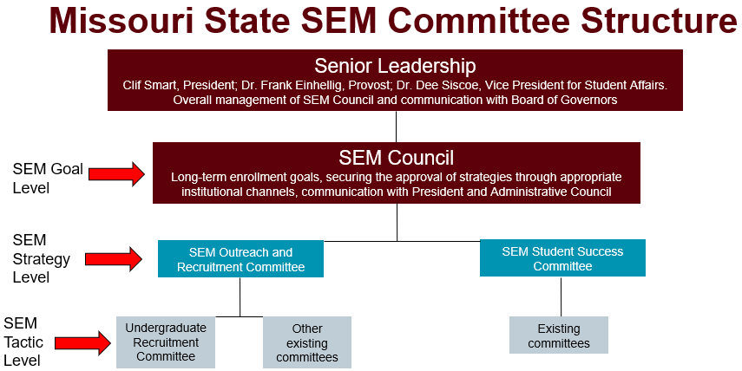
Structure Going Forward

Slide 15
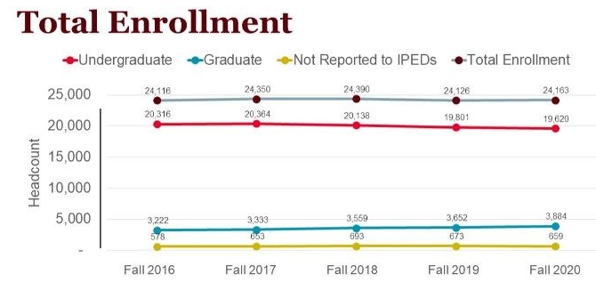
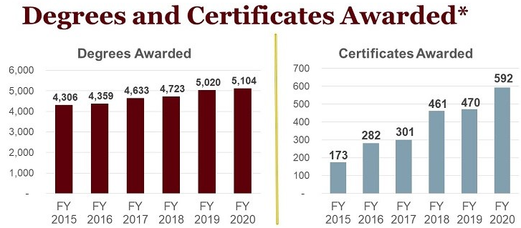
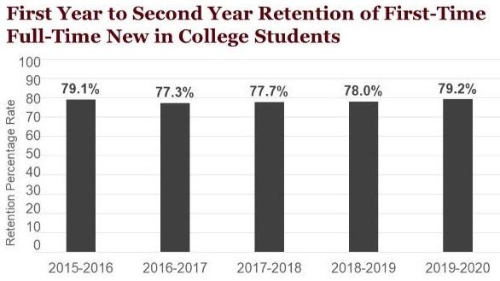
Assessment
Spotlight KPI’s
Reporting dashboards for goals, strategies, and tactics

Slide 16
How are we going to achieve this?
Recognize tactic level initiatives already taking place
Existing committees (e.g., Undergraduate Recruitment Committee)
Title III Grant – financial literacy and career outcomes
Marketing certificates (with no prerequisites)
Proactive Registration – Registrar, colleges, advisors, Residence Life, Multicultural Student Services, Veterans
Texting communication system
College recruitment plans, admit reports, career outcomes information…
Make sure proposed new initiatives fit within the goals and strategies of the plan
Continue to be data driven
Continue to monitor internal and external opportunities and challenges
Allow for adjustments, when appropriate

Slide 17
Discussion

