Slide 1
How to Complete Federal Direct Loan Exit Counseling
Notes:
Congratulations on your upcoming graduation! As someone who has borrowed through the federal student loan program you have an additional requirement before the big day.

Slide 2
What is Federal Direct Loan Exit Counseling?
Online process
No in-person appointment necessary
Required by the Department of Education
Notes:
You can complete Federal Direct Loan Exit Counseling at your convenience since this process is entirely online. No need to schedule an appointment, unless you have follow up questions. Remember, this is a Department of Education requirement for students who borrowed federal loan funds.

Slide 3
What is the purpose of Exit Counseling?
Remind you of the total amount of federal aid you have borrowed
Provide the name and contact information for your federal loan servicer
Explain the terms and conditions of your student loans
Identify the various loan repayment plans
Notes:
This online counseling reminds you of how much you have borrowed in federal loan funds and provides you with the name and contact information of your assigned federal loan servicer, which is the company that will collect your monthly loan payment. Counseling also reviews the terms and conditions you agreed to back when you completed Entrance Counseling and reviews the various loan repayment plans.

Slide 4
Who needs to complete Exit Counseling?
All students who have borrowed through the Federal Direct Loan program
Students graduating in May 2021, even if you will be reenrolling in another degree program
Notes:
If you borrowed through the federal student loan program and have not yet repaid those funds, Exit Counseling is required. For students who plan to continue their education, yes, you need to complete Exit Counseling to wrap up your current degree program.

Slide 5
What do I need to complete Exit Counseling?
FSAID (your username and password used to complete the FAFSA—not your parents)
Names, mailing addresses, email addresses and phone numbers of two references with different addresses
Details on your post-graduation income and living expenses (if known)
Notes:
Be sure to have everything you need before starting the Exit Counseling as the lesson will timeout due to non activity. If you’ve forgotten your FSAID, click on the link to reset. You will need contact information for two people who do not share the same address to list as references at the end of the counseling.

Slide 6
How long will this take to complete?
20 to 30 minutes is the expected time of completion
Must complete in a single session—cannot save
Notes:
Set aside at least 30 minutes to complete the counseling. You cannot save the counseling to complete later.

Slide 7
What is the deadline to complete Exit Counseling?
Friday May 7, 2021
The Financial Aid Office will receive confirmation within 72 hours after you complete Exit Counseling
Notes:
Please complete Exit Counseling at your earliest convenience and before graduation. The Department of Education will then notify our office within 72 hours after you have successfully completed Exit Counseling.

Slide 8
Helpful tips:
Use Chrome or Firefox
After 3 attempts to log-in with your FSAID, you will be locked out for 30 minutes
Complete counseling in a singe session—cannot save work to complete at a later time
Notes:
The Department of Education’s website functions best on either Chrome or Firefox. Know you FAFSA username and password or you’ll get locked out. Once you start the counseling, you must finish in a single session.

Slide 9
Visit StudentAid.gov and Log In
Notes:
Start by visiting StudentAid.gov
Log in with your FSAID, also known as your FAFSA username and password.

Slide 10
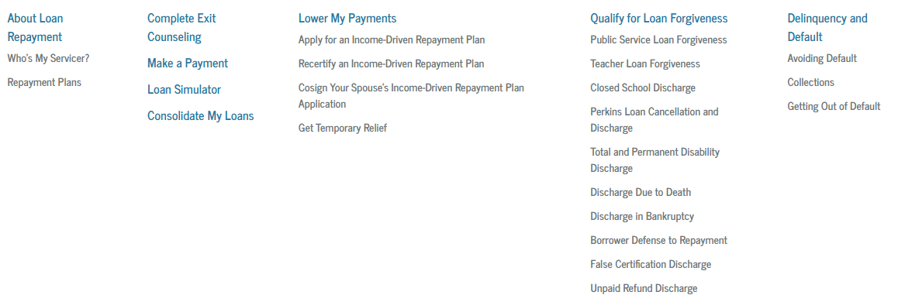
Where do I begin?
Notes:
At the top of the page, hover over Manage Loans to open more options and select Complete Exit Counseling.

Slide 11
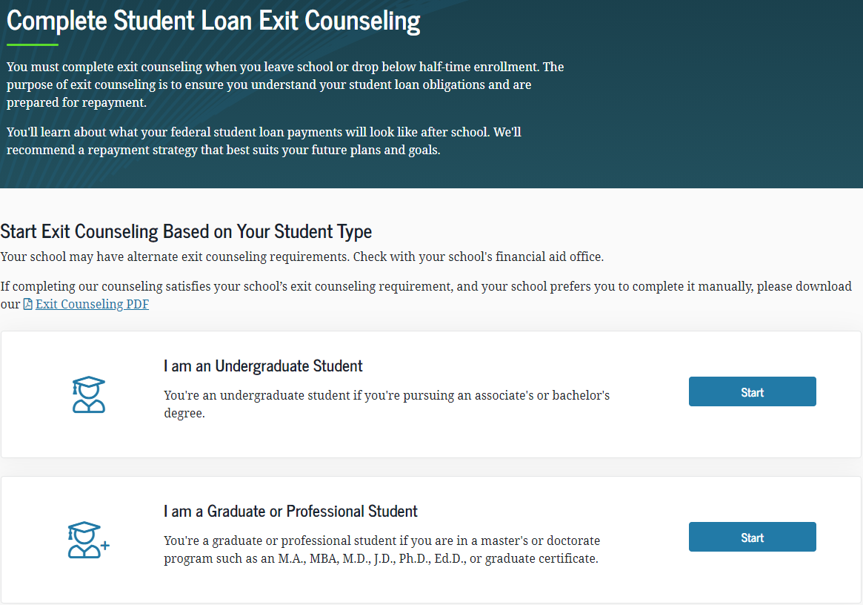
Select undergraduate or graduate to Start
Notes:
Select either undergraduate or graduate depending on the degree program you are completing.

Slide 12
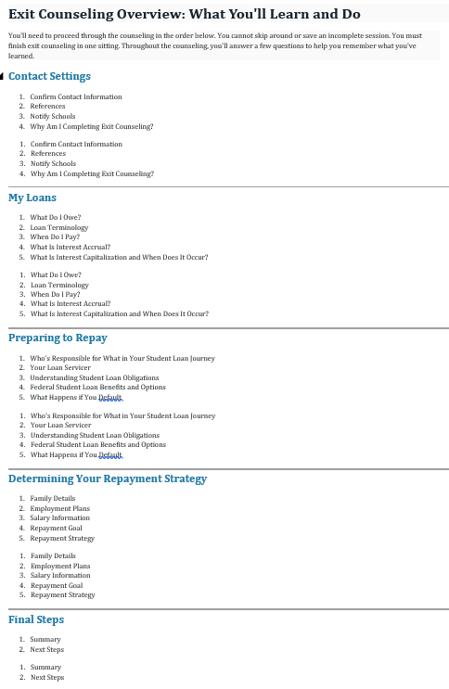
Consists of 5 modules
Notes:
Exit Counseling consists of 5 modules to work through. Remember, keep going since you cannot save your work.

Slide 13
Take your time to read through each module until you reach the end.
Notes:
Take your time to read through each module, answer questions, and provide your personal information until you successfully complete Exit Counseling.

Slide 14
Questions?
Send us an email
RealLife@Missouristate.edu
VictoriaJacobson@missouristate.edu
Schedule a meeting with Victoria
Notes:
Still have questions, contact Victoria Jacobson by email or schedule a meeting with her and select the Exit Counseling option.

